Slide 1
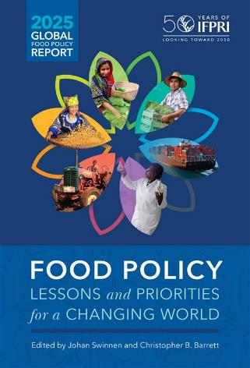
Christopher B. Barrett
Cornell University
and Chair, IFPRI Strategy & Program Council
June 18, 2025
Presentation to InterAction’s
Food Security and Nutrition Working Group

Slide 2
Table of contents
IV: Transforming Lives &
Livelihoods
Social Protection
Nutrition & Diets
Fragility & Conflict
Gender Research
I: Introduction
IFPRI’s Impact
Agrifood Systems
II: Sustainability & Natural Resources
Climate Change
Environmental Sustainability
Tenure
Food Value Chains
V: Effecting Change
Political Economy & Governance
Agrifood Trade
Agricultural Innovation Policies
Financing
III: Supporting Farmers
Agricultural Extension Services
Quality Seeds, Improved Varieties
Insurance
VI: Regional Developments
19-24. Africa, Central Asia, South Asia, East & SE Asia, Middle East & North Africa, Latin America

Slide 3
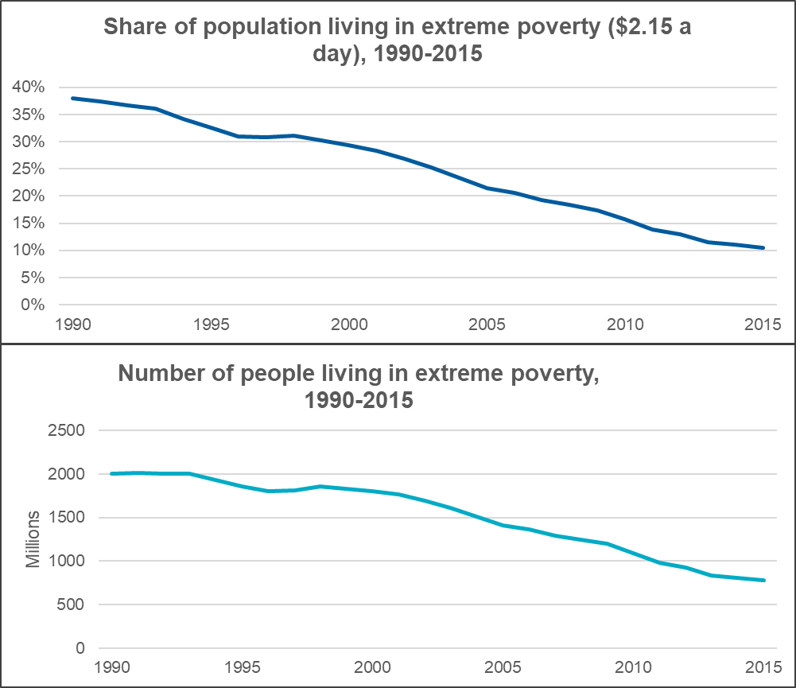
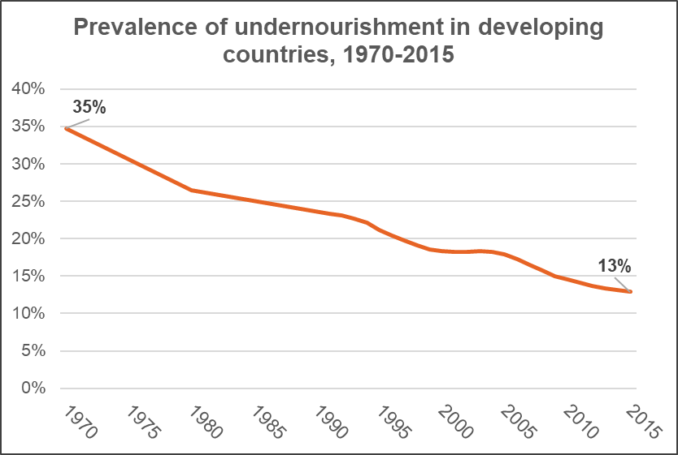
1975-2015: Unprecedented progress in reducing hunger and poverty while population ~ doubled (3.7 to 7.3 bn)
Data: FAO
Data: World Bank Poverty and Inequality Platform

Slide 4
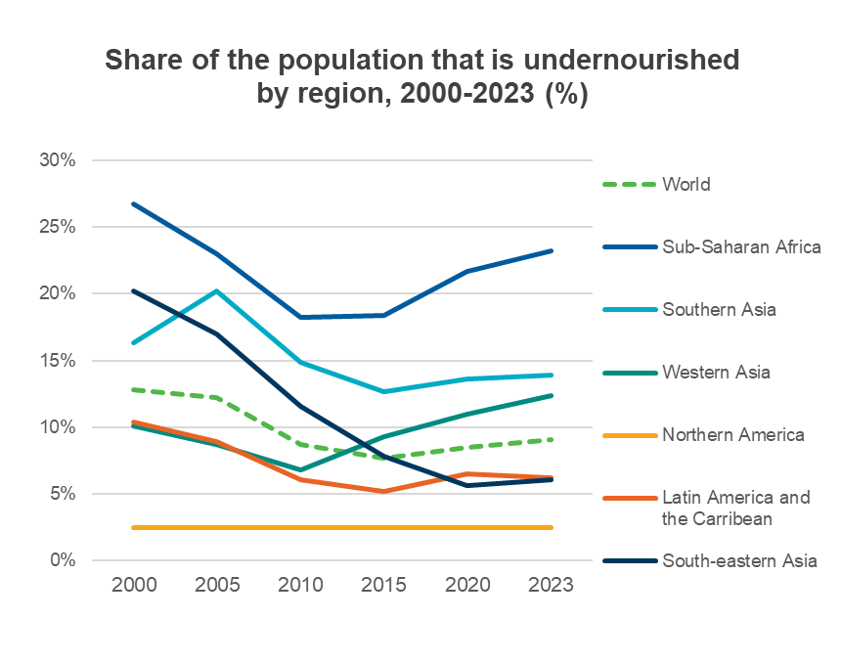
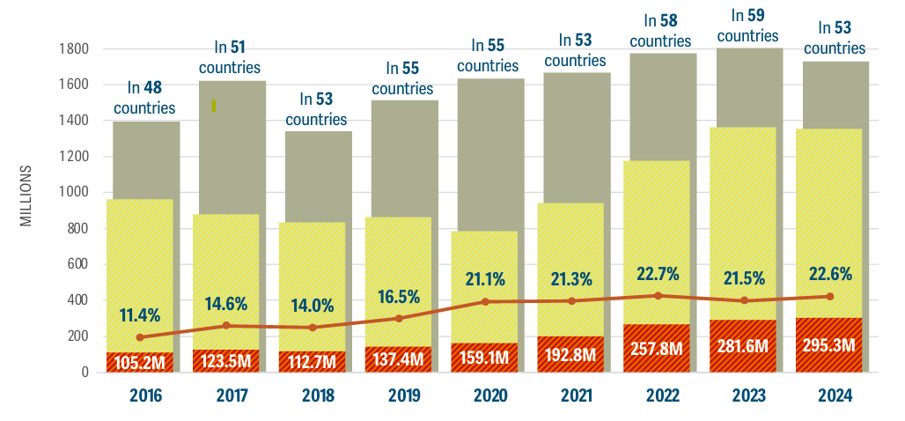
The past decade:
Stagnation and reversal in hunger and poverty
Acute food insecurity has almost tripled since 2016
Credit: Global Report on Food Crises 2025
Data: FAO
Notes:
World Spending on Agricultural Research and Development | Agricultural Policy Review

Slide 5
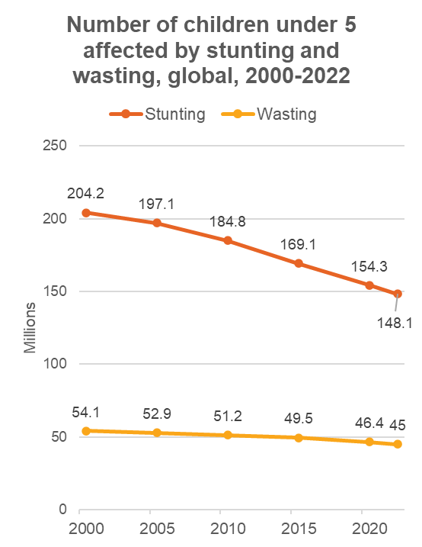
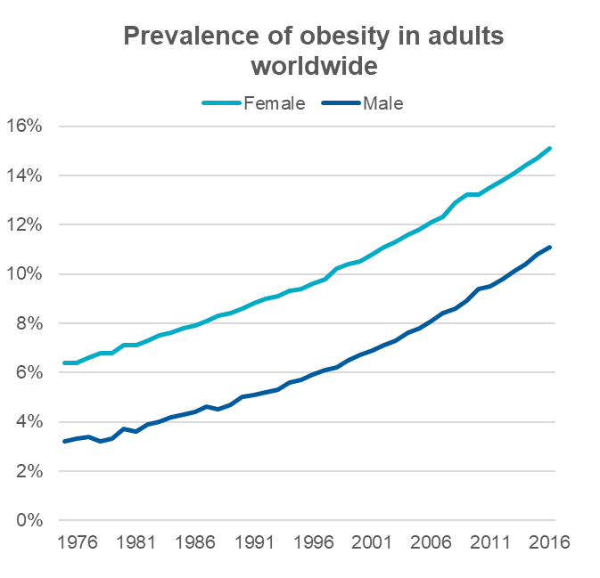
Mixed progress on nutrition and health
2 billion
people are affected by micronutrient deficiencies
3 billion
people cannot afford a healthy diet
1 in 5
lives could be saved each year by improving diets
Data: WHO
Credit: UNICEF, WHO, World Bank Group

Slide 6
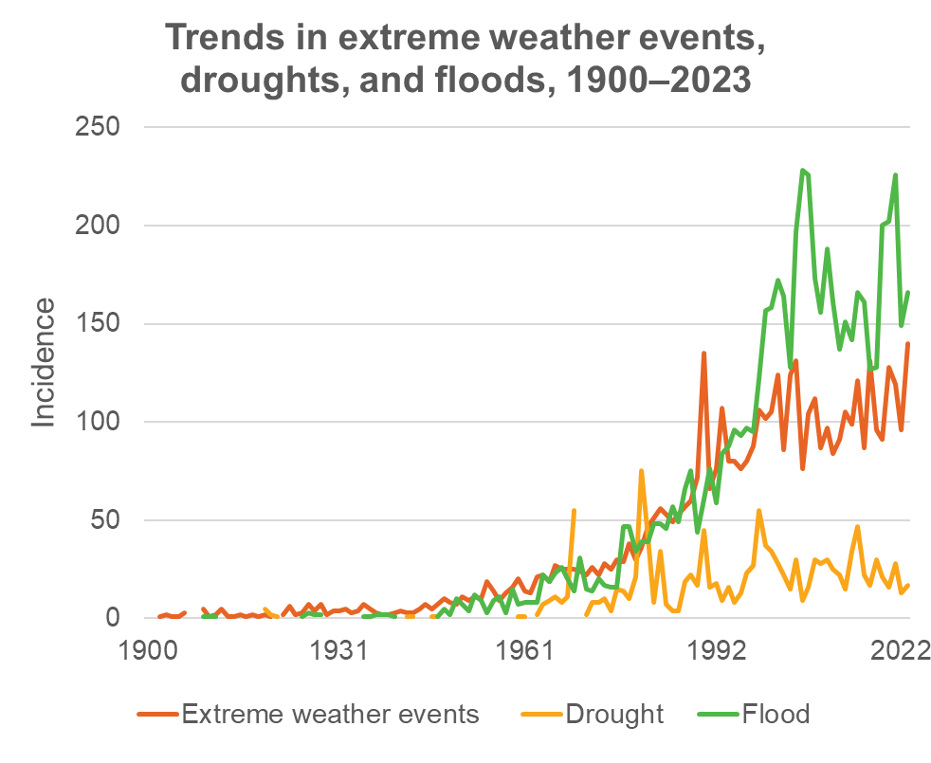
Externalities and sustainability of food production
Agriculture and the food system
consume >30% of energy
produce >30% of GHG emissions
use >70% of freshwater resources
major contributor to biodiversity loss and novel infectious diseases due mainly to land use change
environmental and health hazards due largely to excess agrochemical inputs

Slide 7
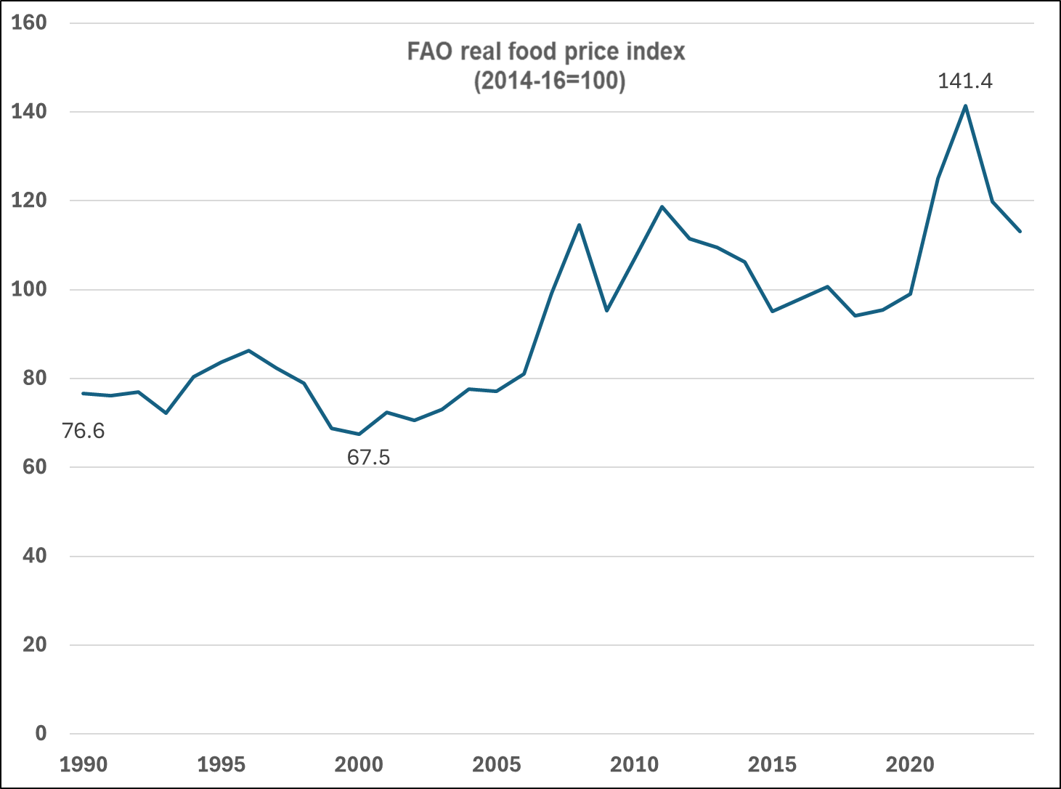
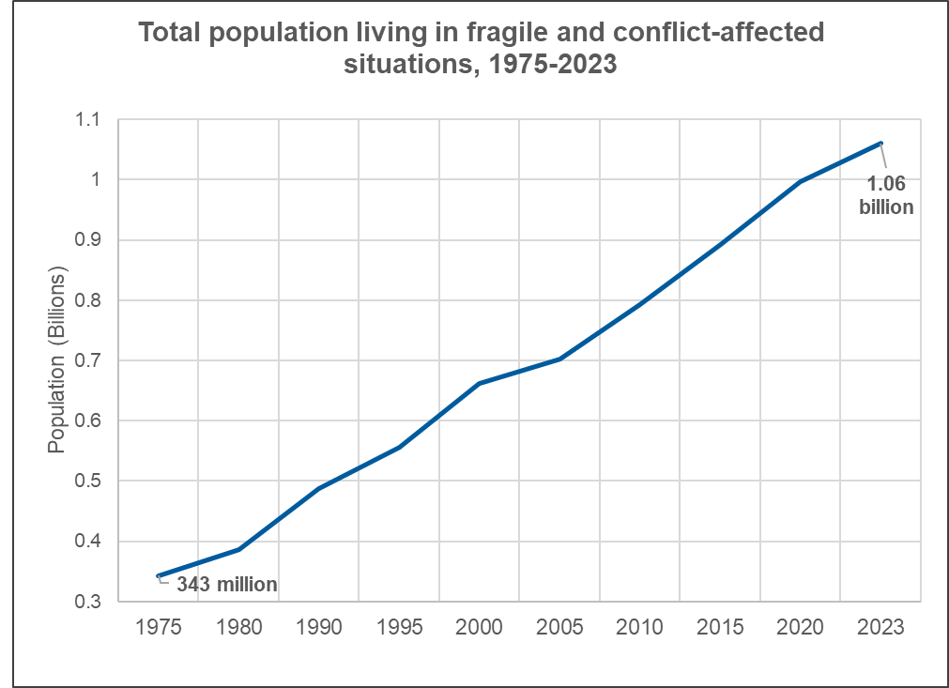
Increased volatility, shocks, and conflict
Data: FAO, World Bank
Notes:
Food price volatility

Slide 8
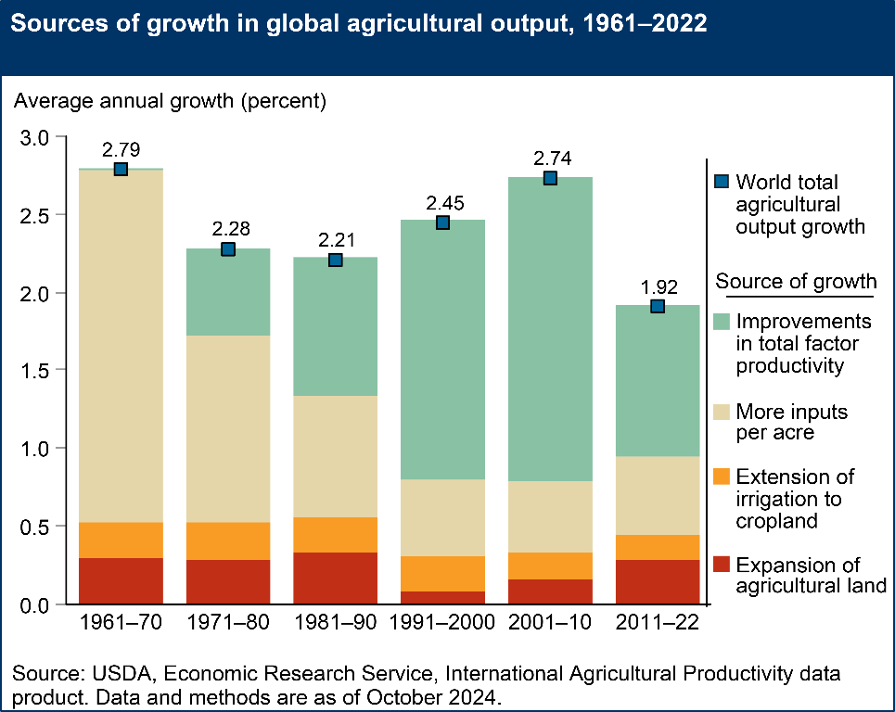
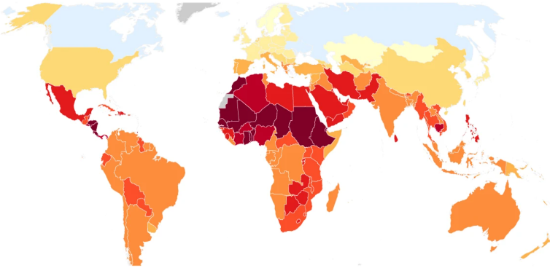

Slowing agricultural productivity growth
Country-level impacts of
climate change on agricultural TFP
Credit: Ortiz-Bobea et al. 2021

Slide 9
Expanding role of private sector in food systems
Primary agriculture
Input supply
Trade & transport
Agroprocessing
Trade & transport
1
Share of total GDP in 2021 (%)
2
Share of agrifood system GDP in 2021 (%)
Food services
Agriculture and the agrifood system contribute less to the overall economy in more developed countries
Off-farm components are more important parts of the agrifood system in more developed countries
LIC = low-income | LMIC = low-middle | UMIC = upper-middle | HIC = high-income
Source: IFPRI Global Agrifood System Database of 217 countries (2023)

Slide 10
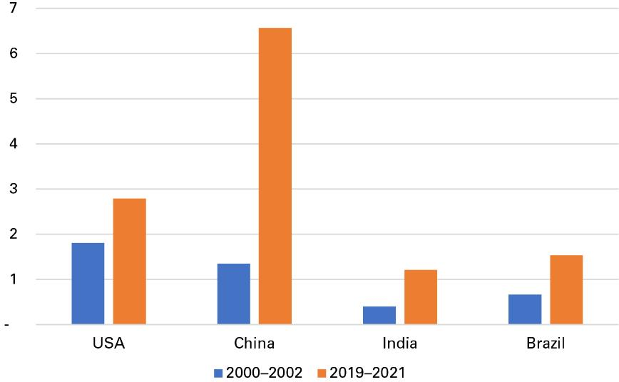
Shifting financial landscape
Spending on agricultural knowledge and innovation systems ($US billion), 2000–2002 and 2019–2021.
Global shifts in ag and food R&D
  Growth in MICs
  Shift to private sector
  Continued underinvestment in many LMICs and USA
Global shifts in ODA
  Significant growth in past
  Shift from traditional to new funders
  Uncertain future: fell by 7.1% between 2023 and 2024 and is projected to decline by a further 7.9% in 2025.
Data: OECD (2022)
Notes:
CGIAR funding and Africa investment

Slide 11
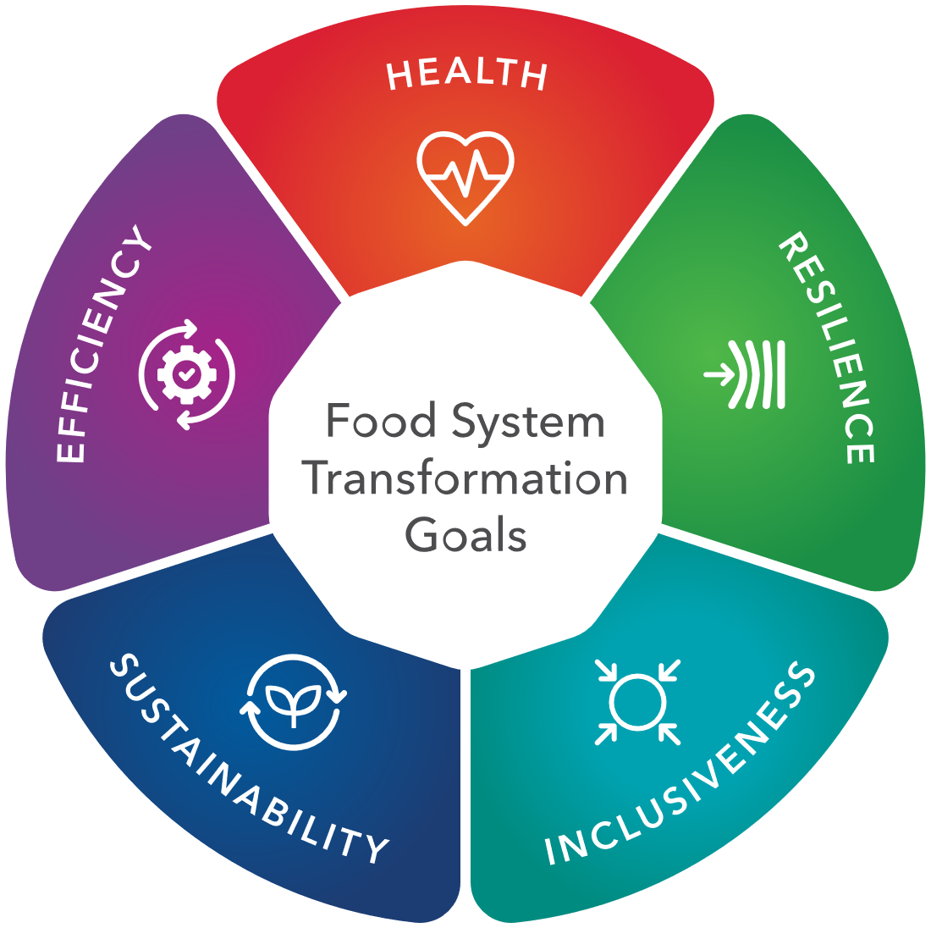
Food policy priorities for the future
Focus on resilience and inclusion for vulnerable people and places and on boosting productivity, above all in Africa/Asia
Improve diets, nutrition, and food environments
Embrace the challenge of new technologies
Engage with the private sector and value chains to meet food systems goals
Leverage public investments, mobilize private $
Partner and build capacity for interdisciplinary research and policymaking

Slide 12
A research agenda for the future
Looking ahead to 2050, the report identifies six broad priorities for food policy research:
Strengthening resilience and inclusion in food systems everywhere, with special attention to for conflict- and disaster-affected regions and vulnerable groups.
Improving diets and nutrition by addressing the root causes of poor food environments and enabling healthier choices.
Harnessing new technologies responsibly, including digital innovations and AI, while ensuring equitable access and inclusion.
Engaging the private sector to expand investment in food systems innovation, from R&D to sustainable value chains.
Mobilizing and reforming existing public spending, including repurposing agricultural support to align with sustainability and nutrition goals.
Fostering interdisciplinary research and policymaking, breaking down silos between agriculture, health, environment, and trade.
The report also underscores the importance of building local research capacity and partnerships to support evidence-based policymaking in low- and middle-income countries.

Slide 13

THANK YOU to our authors
Sivan Yosef, Tamsin Zandstra, Maria DiGiovanni, Frank Place, Peter Hazell, Suresh Babu, Xinshen Diao, Margaret McMillan, Karl Pauw, James Thurlow, Mark W. Rosegrant, Elizabeth Bryan, Timothy S. Thomas, Keith Wiebe, Claudia Ringler, Wei Zhang, Ephraim Nkonya, Kris Wyckhuys, Sarobidy Rakotonarivo, Ruth Meinzen-Dick, Isabel Lambrecht, Uchendu Eugene Chigbu, Iliana Monterroso, Diana Suhardiman, Tom Reardon, Bart Minten, Sudha Narayanan, Kristin Davis, Rikin Gandhi, Jawoo Koo, Berber Kramer, Alesha Miller, Jona Repishti, David J. Spielman, Rasheed Sulaiman V., Francisco Ceballos, Ruth Hill, Daniel O. Gilligan, Akhter Ahmed, Harold Alderman, Alan de Brauw, Melissa Hidrobo, Kalle Hirvonen, John Hoddinott, Jessica Leight, Shalini Roy, Alemayehu Seyoum Taffesse, Stuart Gillespie, Marie T. Ruel, Jef L. Leroy, Deanna Olney, Anusara Singhkumarwong, Kibrom Abay, Kate Ambler, Jeffrey R. Bloem, Katrina Kosec, Khalid Siddig, Agnes Quisumbing, Hazel Malapit, Jessica Heckert, Bjorn van Campenhout, Jordan Kyle, Danielle Resnick, Jonathan Mockshell, Eugenio Díaz-Bonilla, Madhur Gautam, Joseph Glauber, Will Martin, Valeria Piñeiro, Sherman Robinson, Fousseini Traoré, Rob Vos, Catherine Ragasa, John Lyman, John Ulimwengu, Steven Were Omamo, Ousmane Badiane, Samuel Benin, Kamiljon Akramov, Isabel Lambrecht, Sharanya Rajiv, Shahidur Rashid, S. Mahendra Dev, P.K. Joshi, Purnima Menon, Kevin Z. Chen, Yunyi Zhou, Ke Kou, Shenggen Fan, Brian McNamara, Joaquín Arias Segura, Sikandra Kurdi, Ganna Hassan, Nina Jovanovic, Linda Steinhubel-Rasheed
… and to you for your interest and collaboration

